Slide 1
Fantastic Felt
The Art of Feltboards in Storytime
Laura Bultman
Youth Librarian
Kalamazoo Public Library

Slide 2
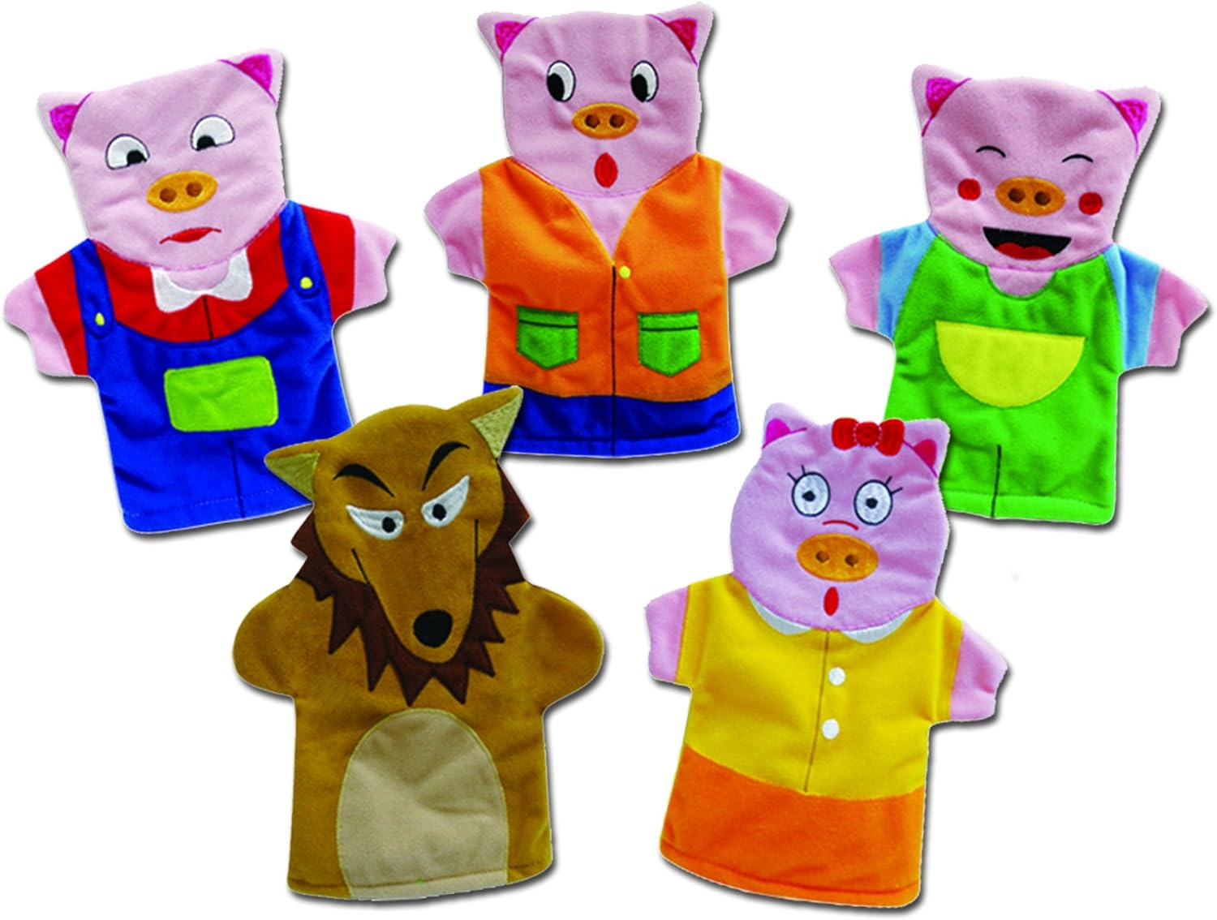
How It Started

Slide 3
Why Use Felt?
Visual Literacy
Sensory/Tactile Experience
Opportunities for Interaction
Provide a framework for storytellers
You can tell the story in your own words
You can make them yourself!

Slide 4
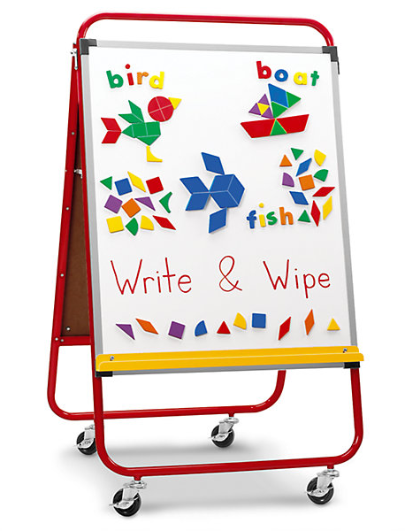
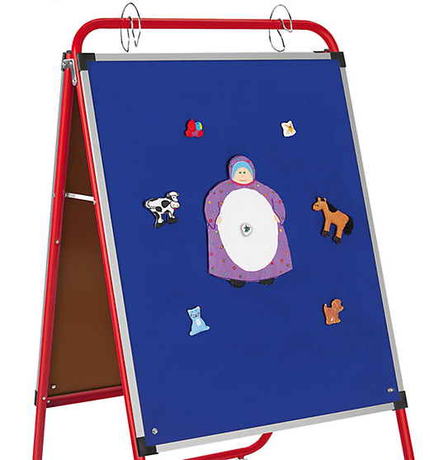
Board Basics
Lakeshore Learning
All-purpose Teaching Easel
$429

Slide 5
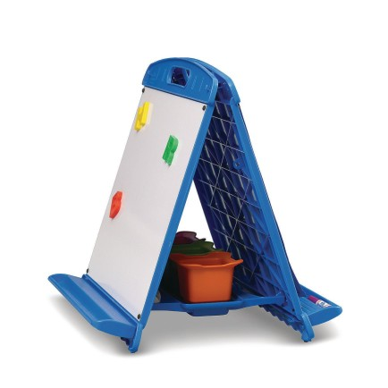
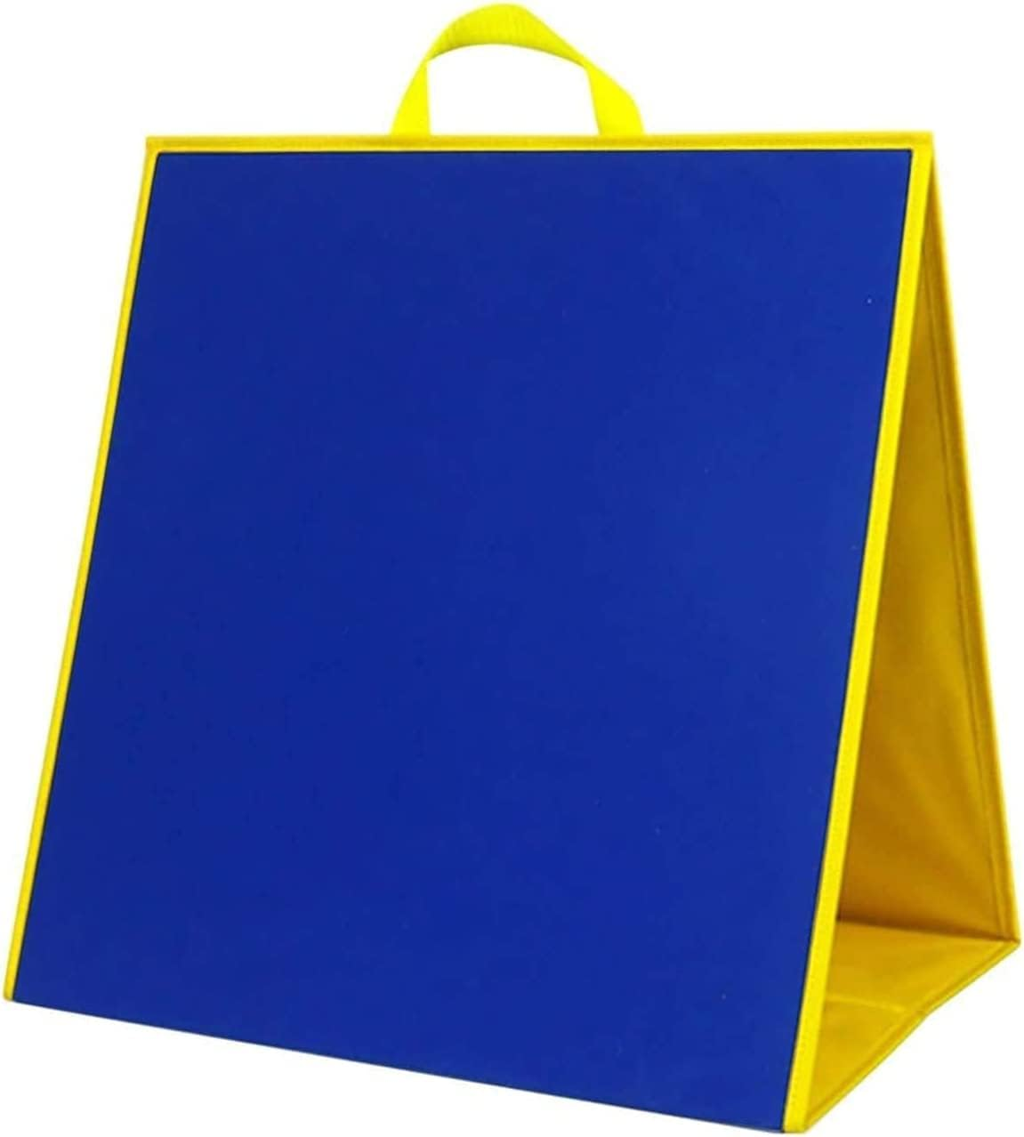
Other Options
Copernicus Folding Magnetic Whiteboard Easel
S&S Worldwide; $76.99
Magnetic Felt from Amazon; $30.46
Topwon Felt Board for Kids
Amazon
$32.99

Slide 6
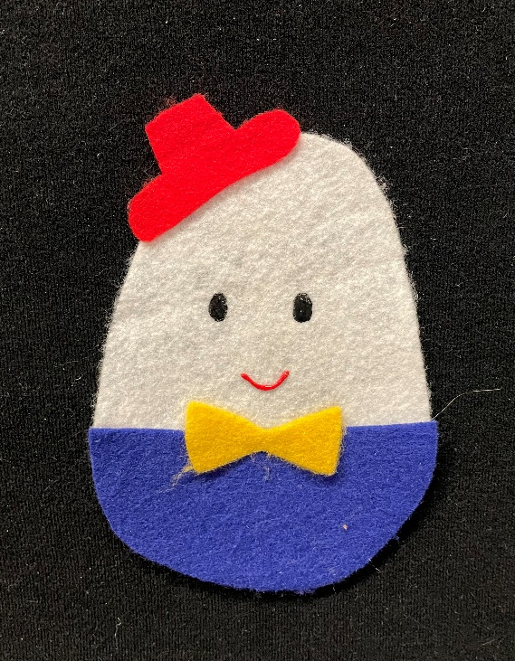
Choosing Songs and Rhymes
Start simple! You can make one piece to represent a song you already sing.
Look for rhymes with movements or other opportunities for interaction (counting, etc).
Is it simple enough for people to sing along?

Slide 7
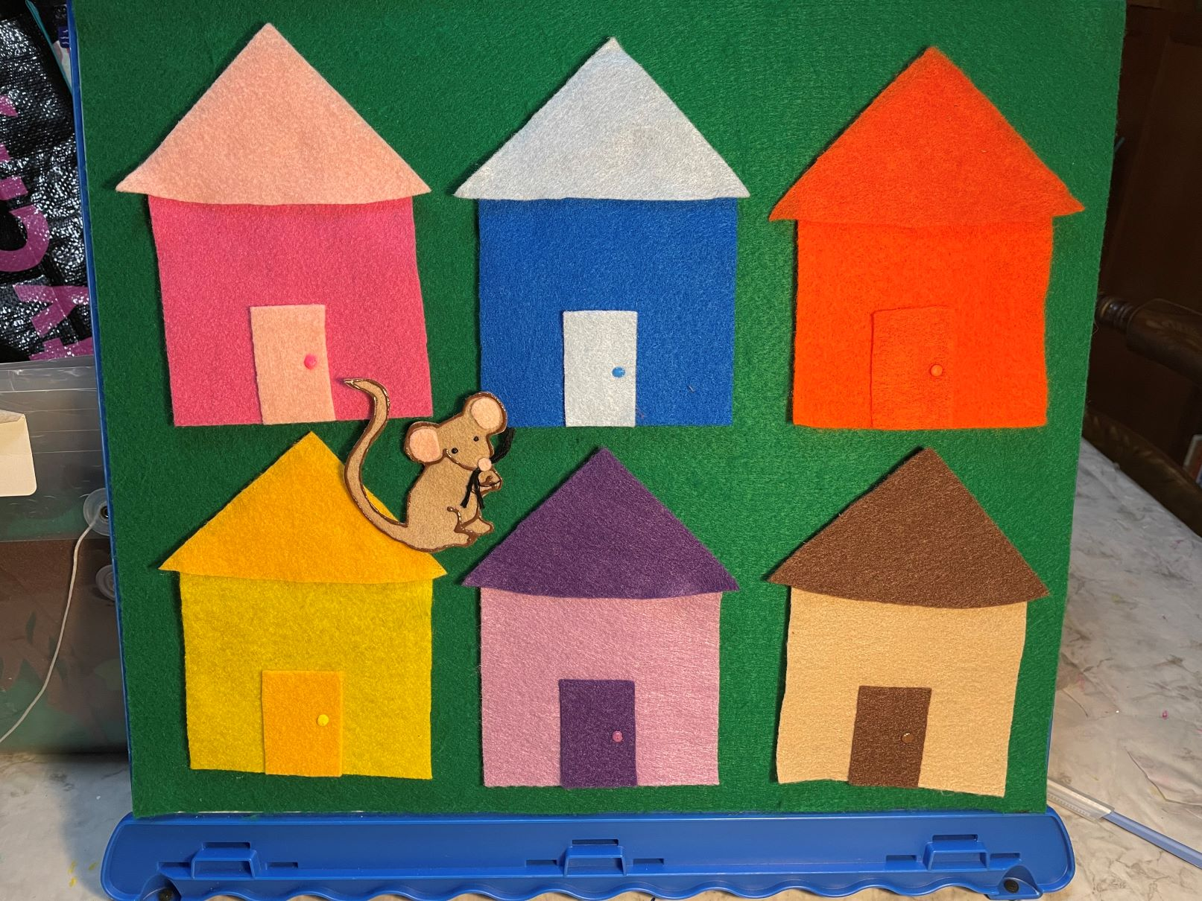
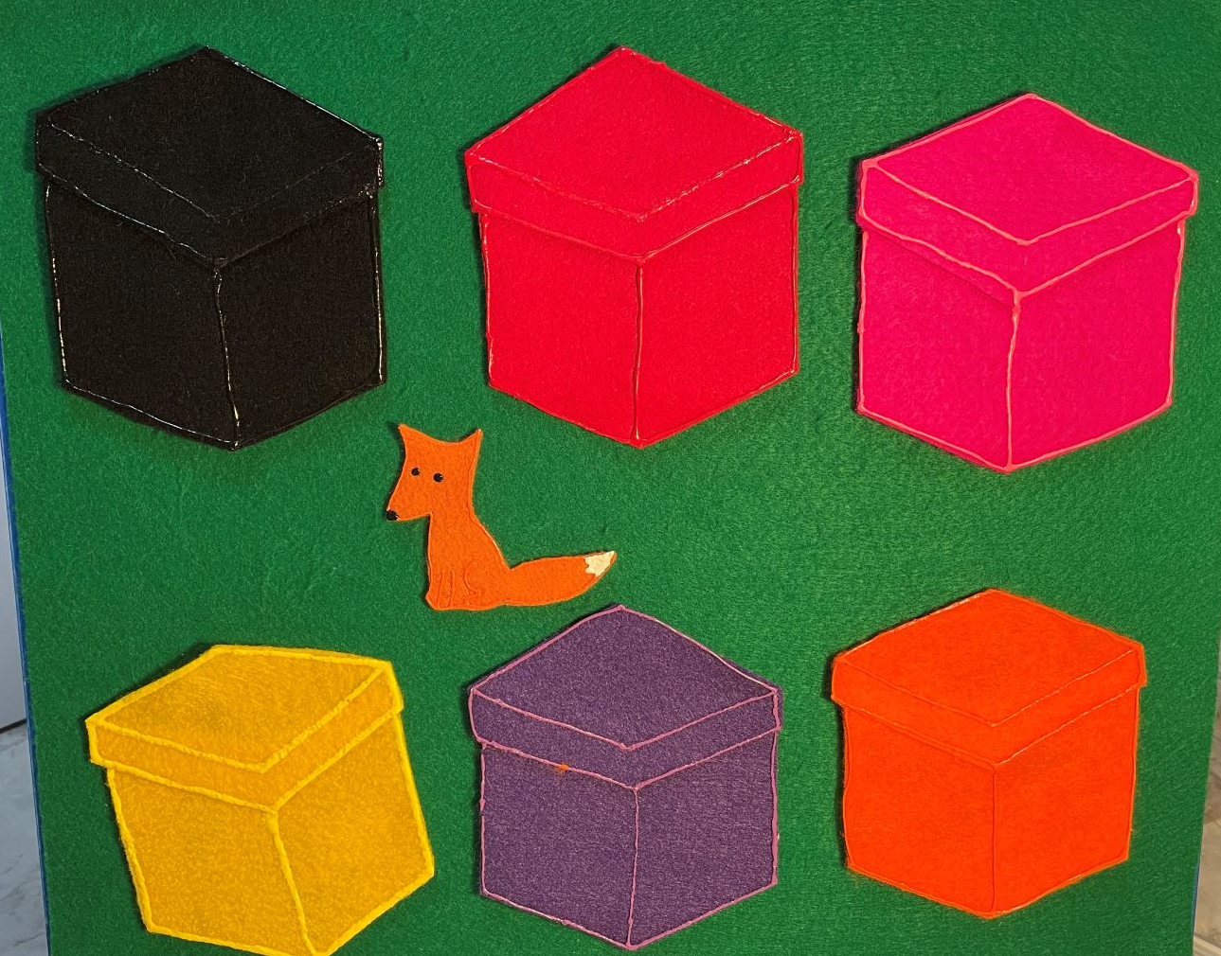
Best of…Songs and Rhymes
Little Mouse / Little Fox

Slide 8
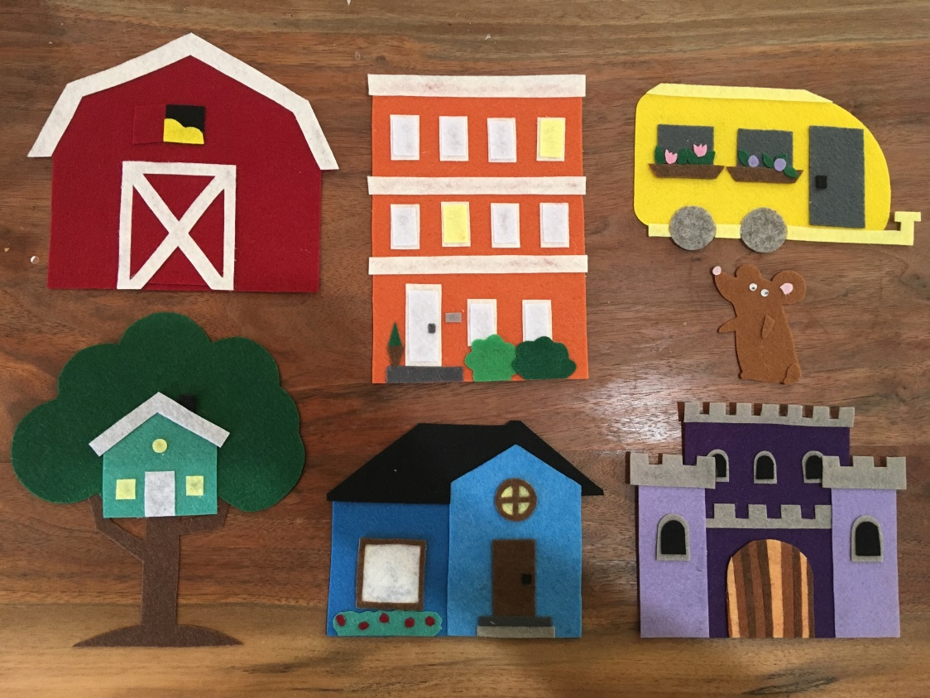
DEI in Flannels
Photo from the Hey There Library blog.
You don’t have to only use houses with colors! Look for ways to represent your community in your flannels.

Slide 9
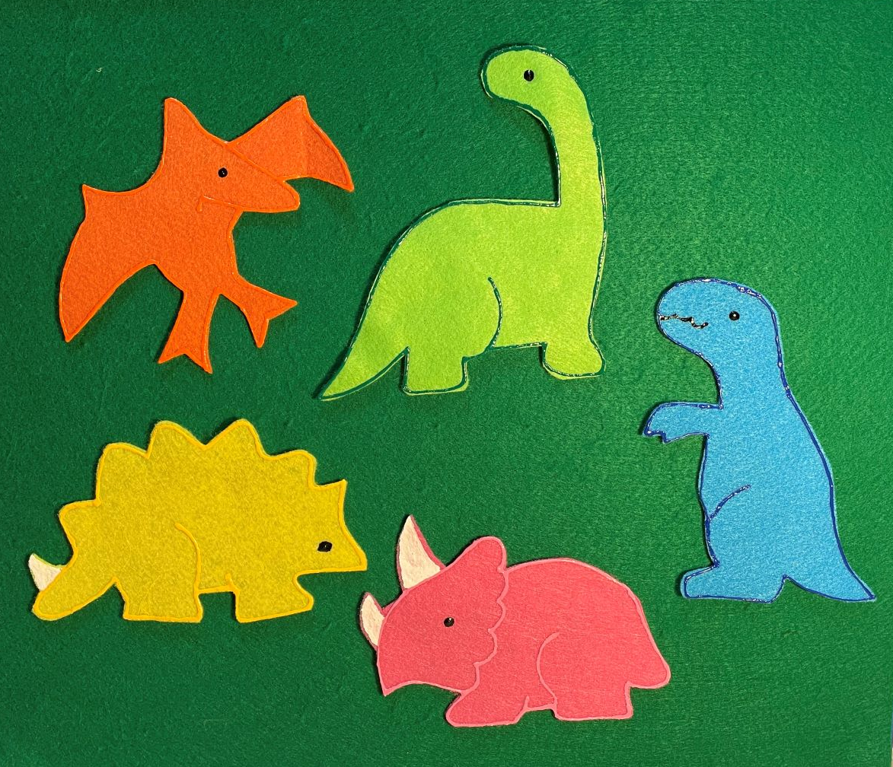
Best of…Songs and Rhymes
Five Little…

Slide 10
But Wait! There’s More!
Use the “Five Little” rhymes to teach early numeracy concepts.
If you change up your characters, the conversations open wide.
Which one is biggest? Which are smallest? Which ones are alike? Which ones are different? What kind do we have the most of?

Slide 11
Choosing Stories
Look for stories with strong plots, repetitive elements or cumulative stories.
Does the story move along? Avoid the “chapter header” stories.
Can the children help tell the story with a repeated refrain or animal they can shout out?
Is there a funny or surprise ending?
Are there a million characters?
Is the book too small to use effectively in storytime?

Slide 12
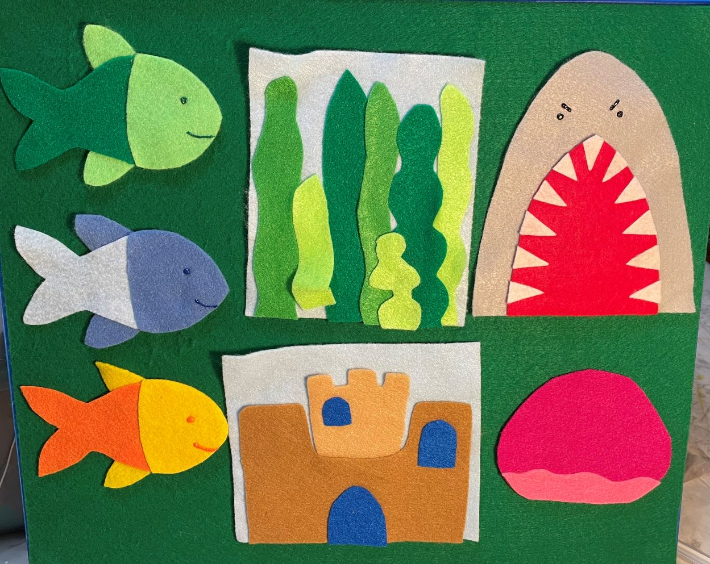
Best of… Stories
The Three Little Fish and the Big Bad Shark

Slide 13
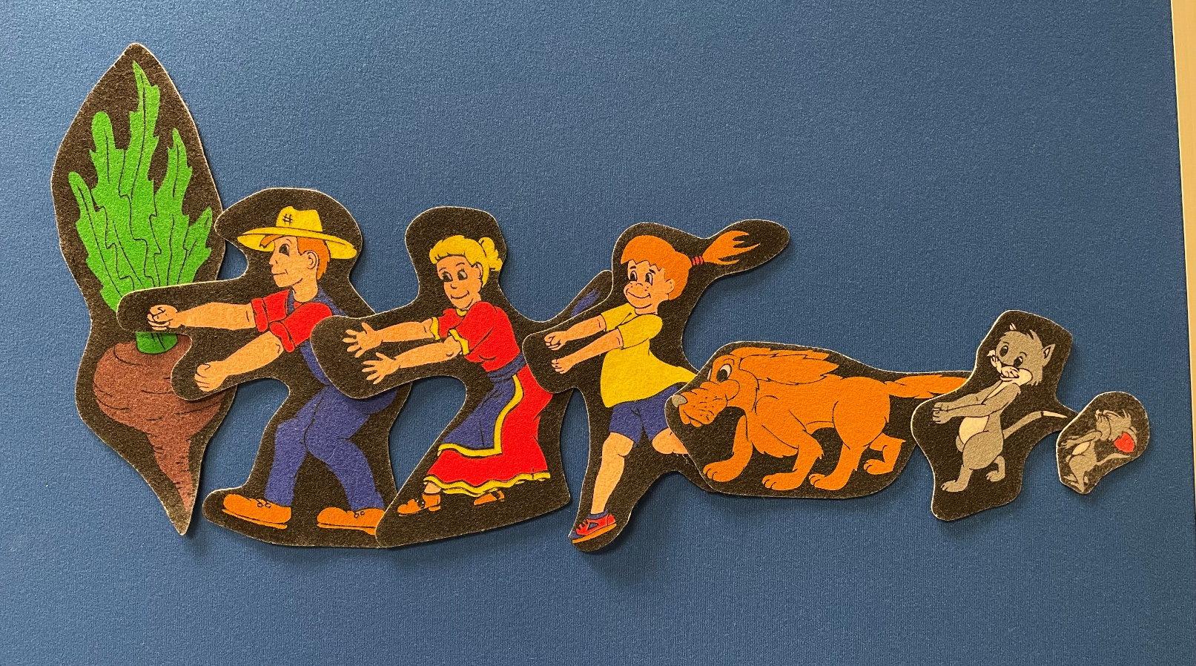
Best of… Stories
The Big Turnip

Slide 14
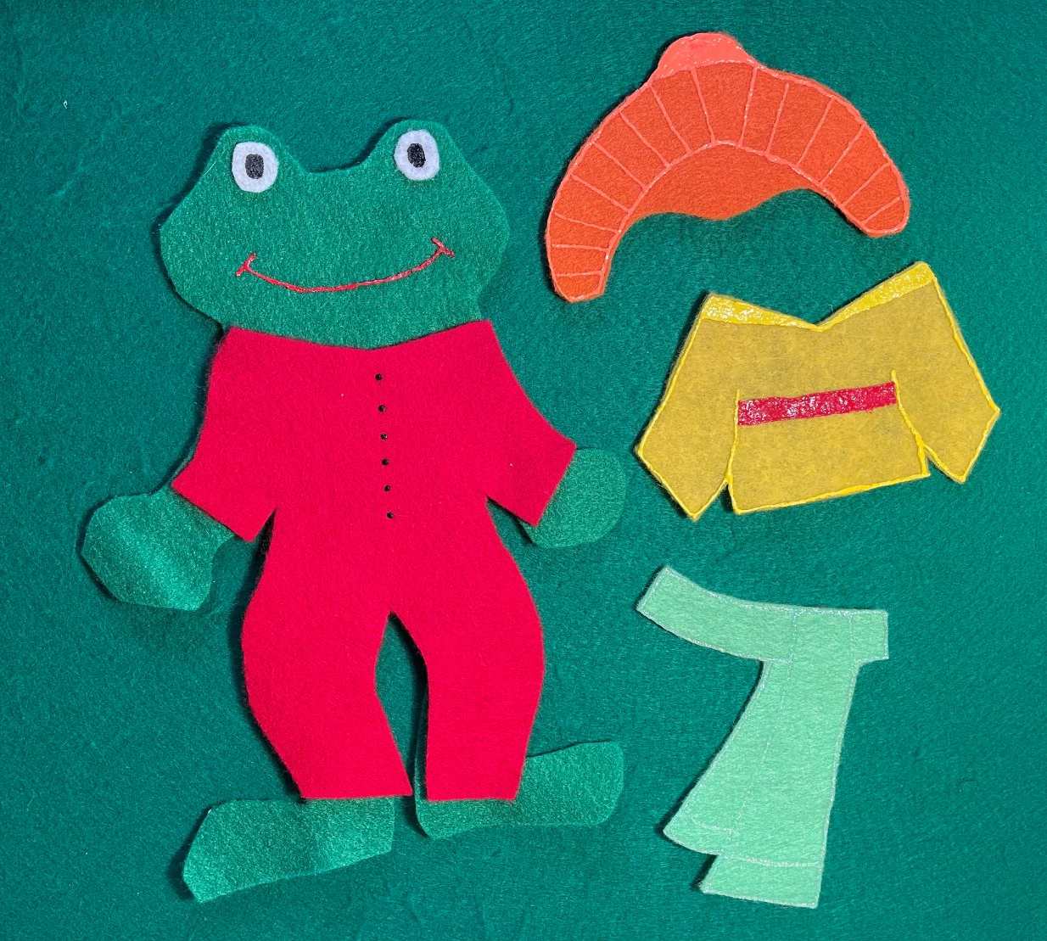
Best of… Stories
Froggy Gets Dressed

Slide 15
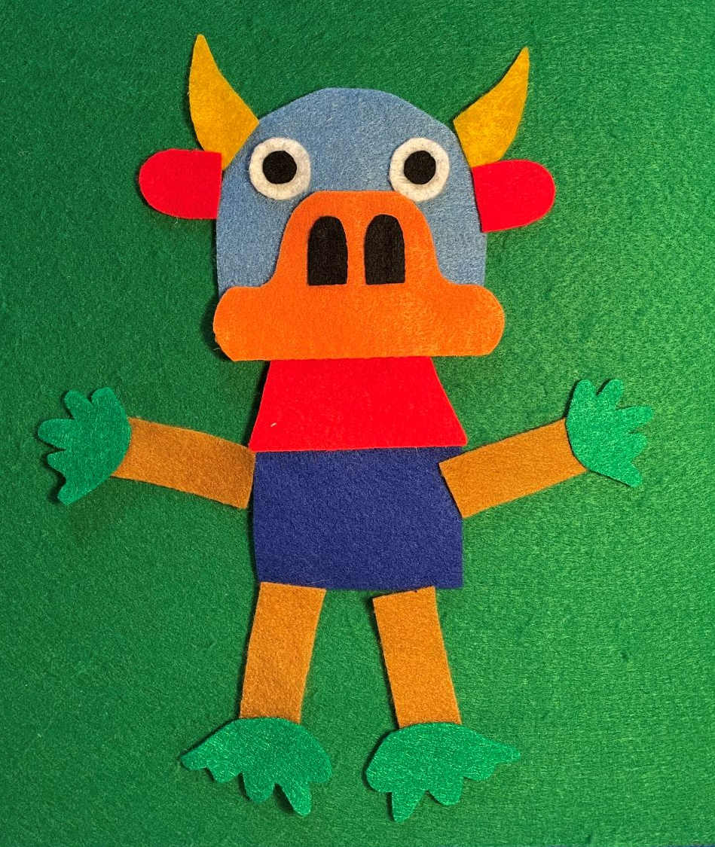
Best of… Stories
The Tickle Monster

Slide 16
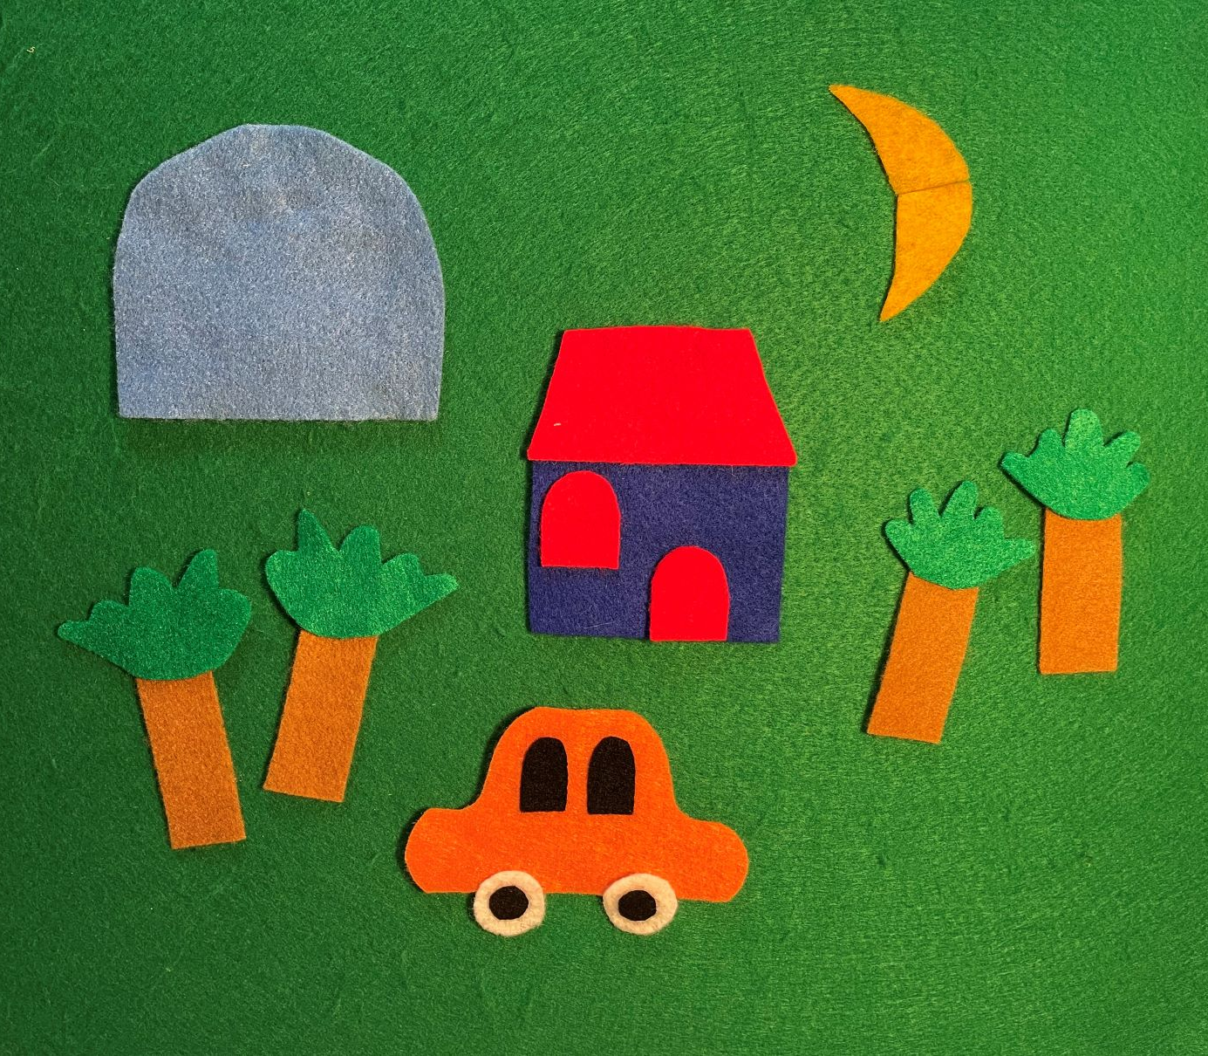
Best of… Stories
The Tickle Monster

Slide 17
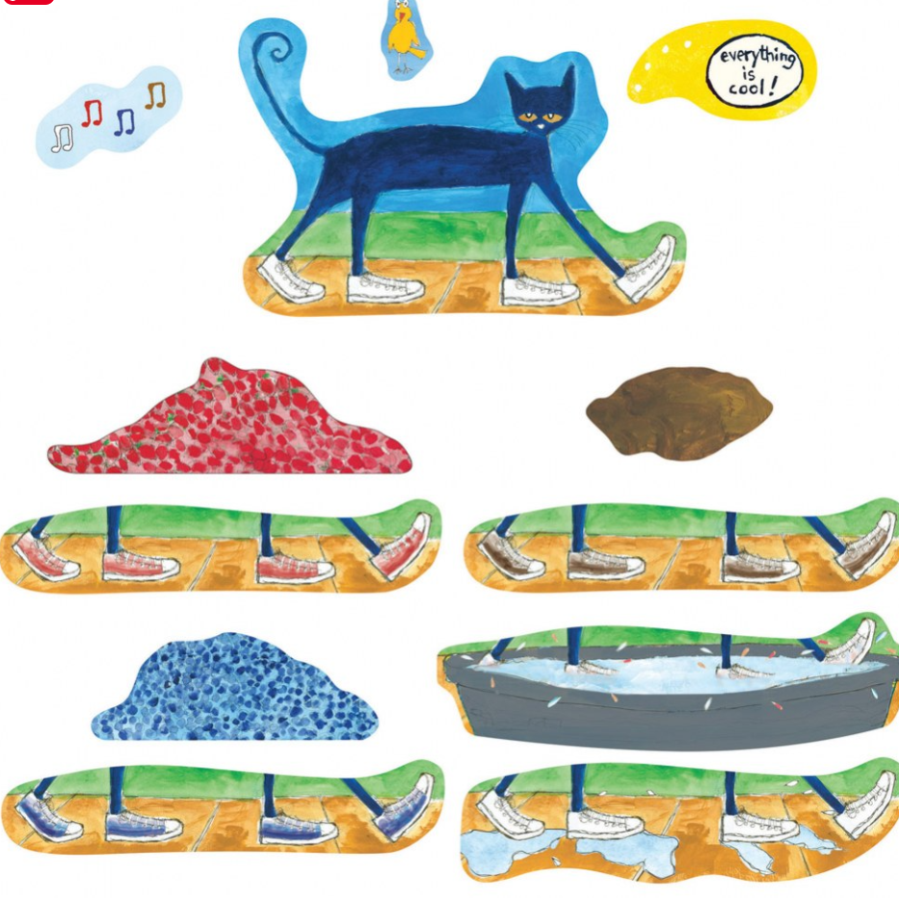
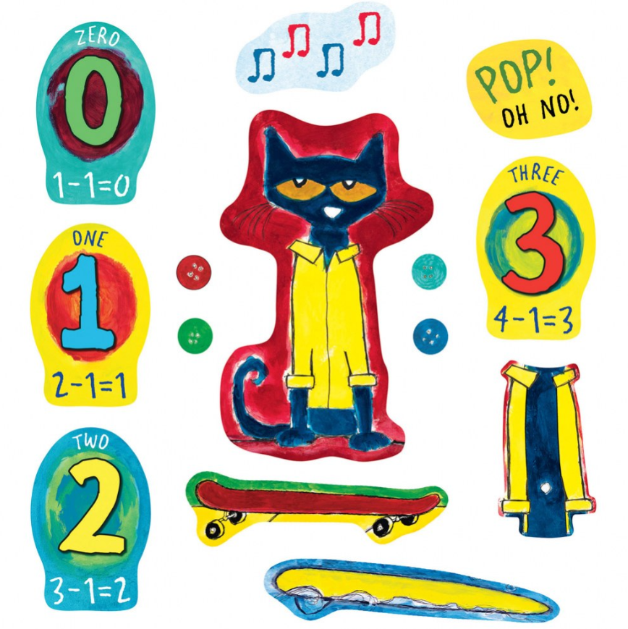
Best of… Stories
Pete the Cat

Slide 18
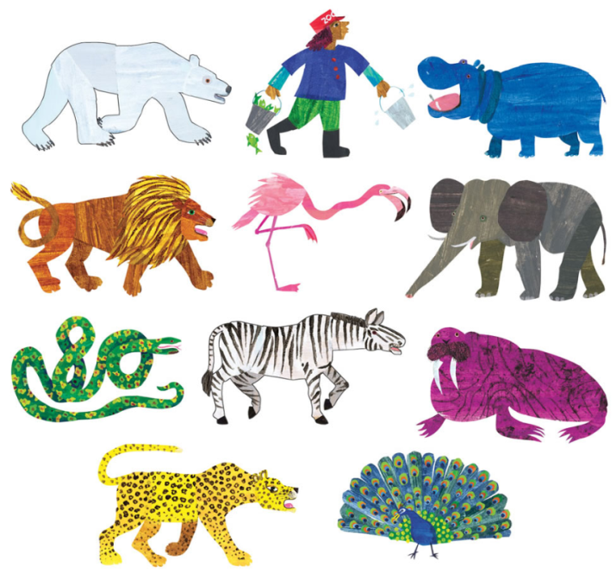
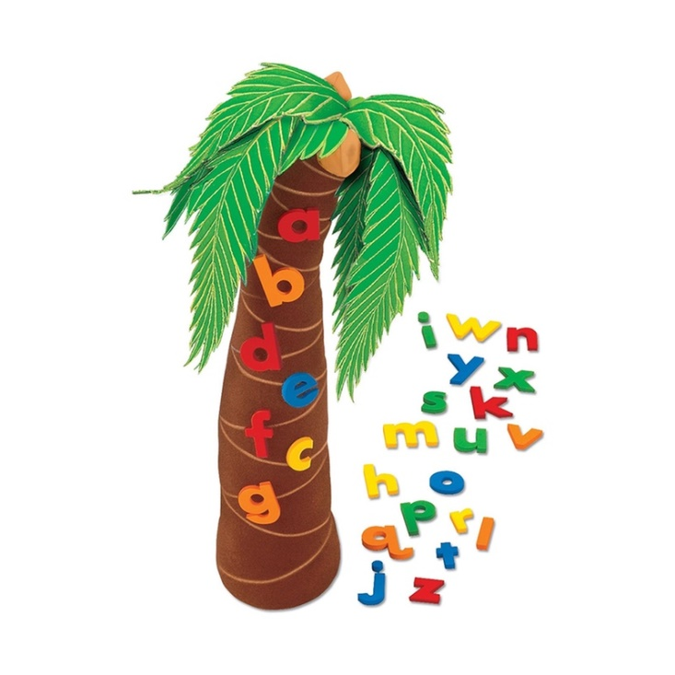
Stories That Don’t Work (FOR ME!) and Why
Polar Bear Polar Bear
The tragic case of the Chicka Chicka tree
Dear Zoo

Slide 19
Telling the Story
Do…
Avoid…
Make sure your pieces fit on the board.
Find a spot for the pieces to be (in order!) before you use them.
Practice!
Speak to the audience, not the board.
Storing the pieces within the reach of your storytimers.
Get tied up in using the exact right/same words from the story or book.
Move the pieces around too much once they’re on the board.

Slide 20
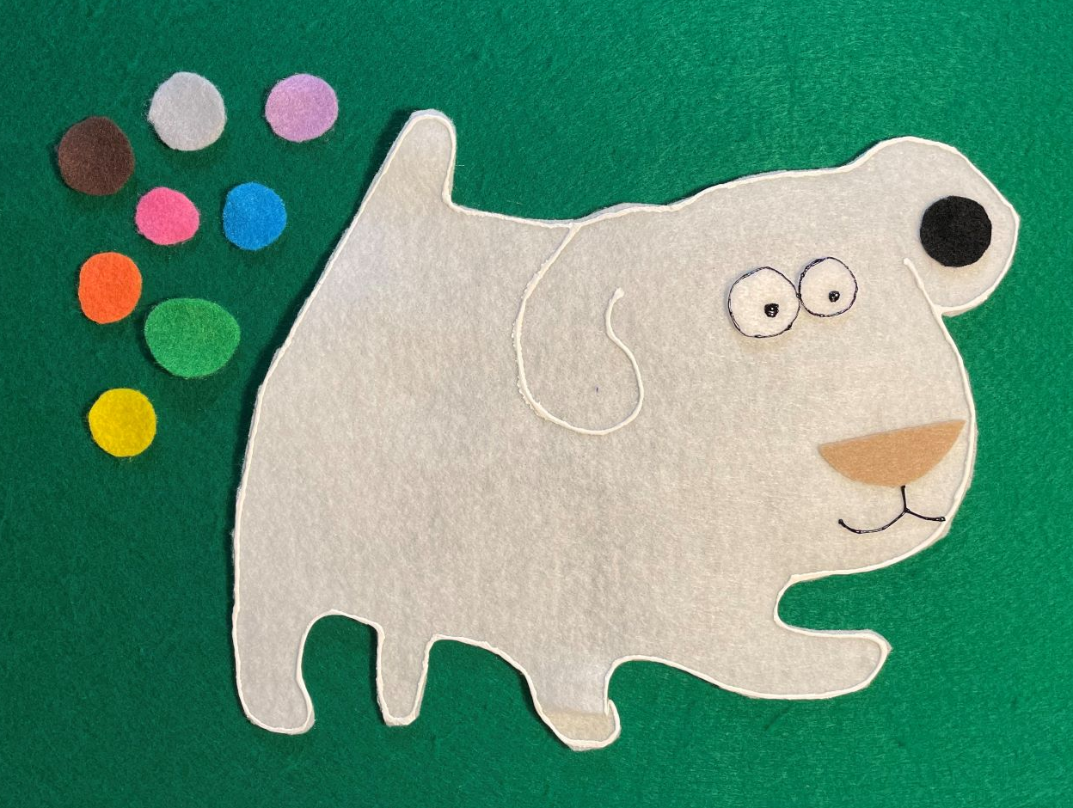
Telling Tales Together
Dog’s Colorful Day

Slide 21
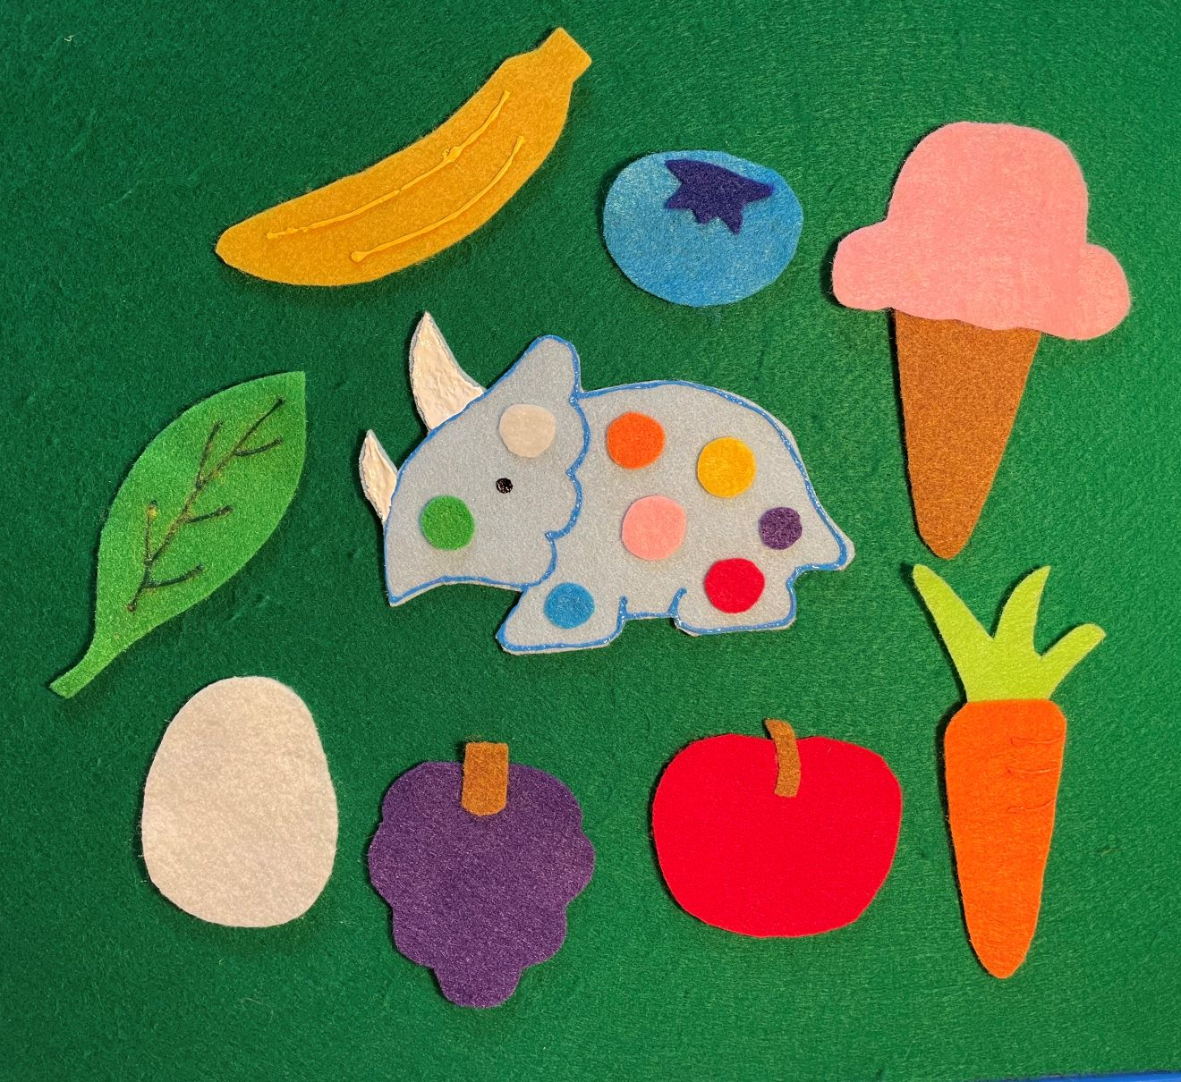
Telling Tales Together
Dotty the Dinosaur

Slide 22
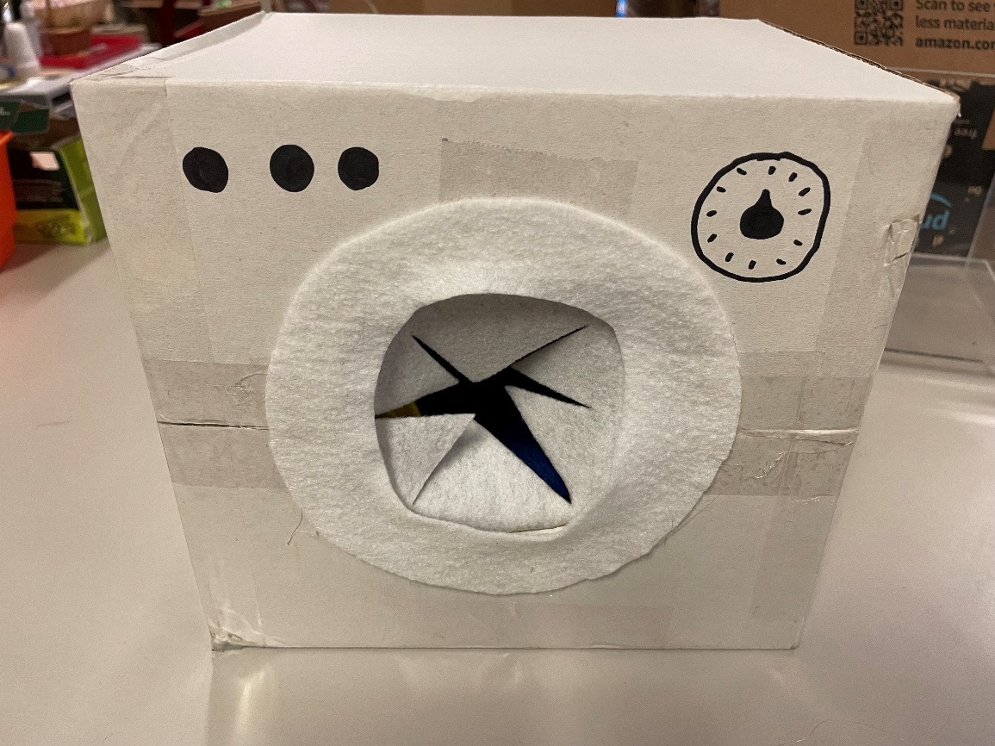
Telling Tales Together
The Socks in the Dryer

Slide 23
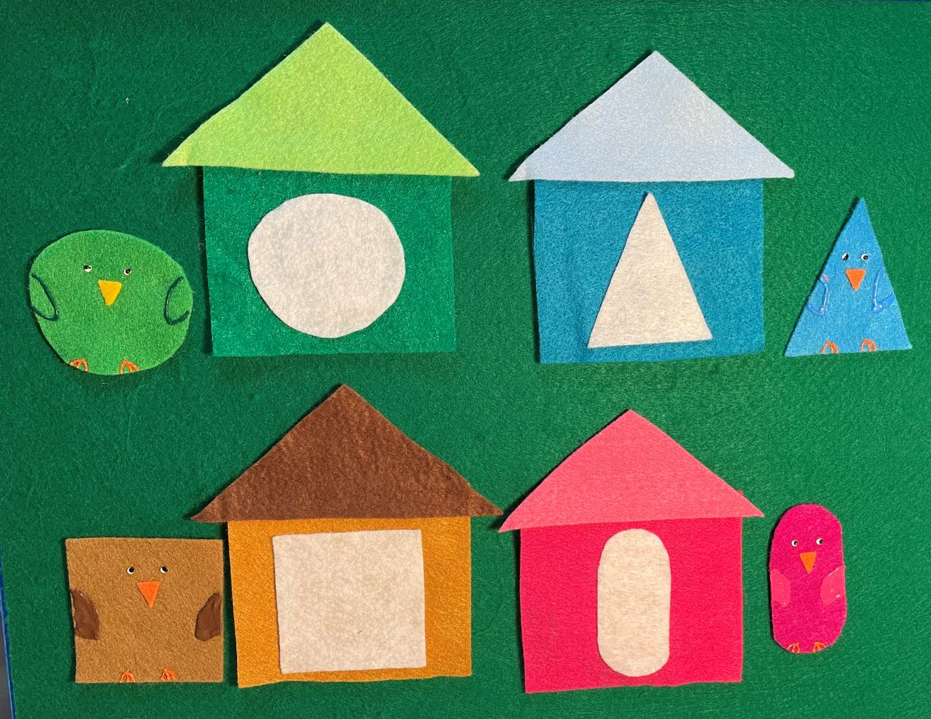
Telling Tales Together
A House for Birdie

Slide 24
Inspiration!
https://storytimekatie.com/flannelboards/
https://flannelfridaystorytime.blogspot.com/
https://storytimeinthestacks.com/flannels/
LalalaLibrary Blog

Slide 25
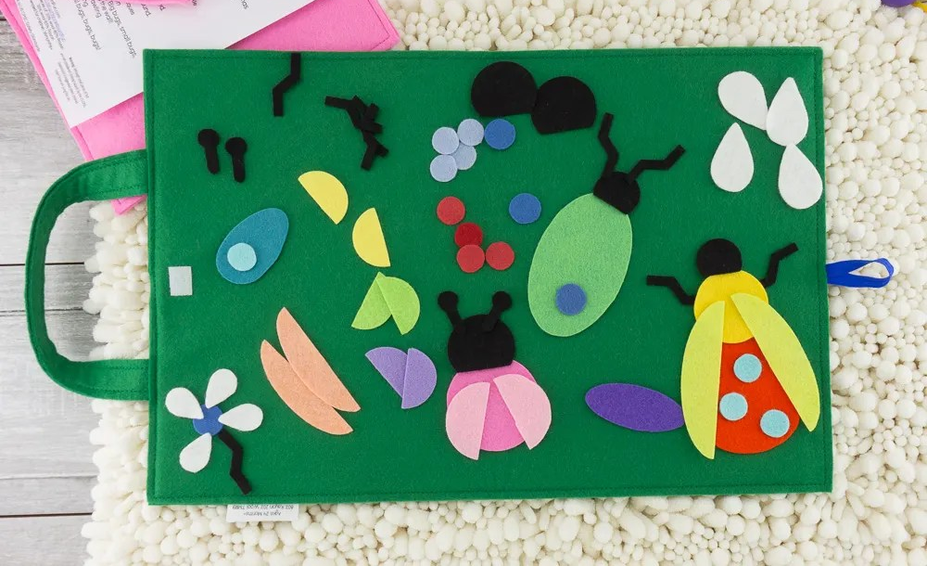
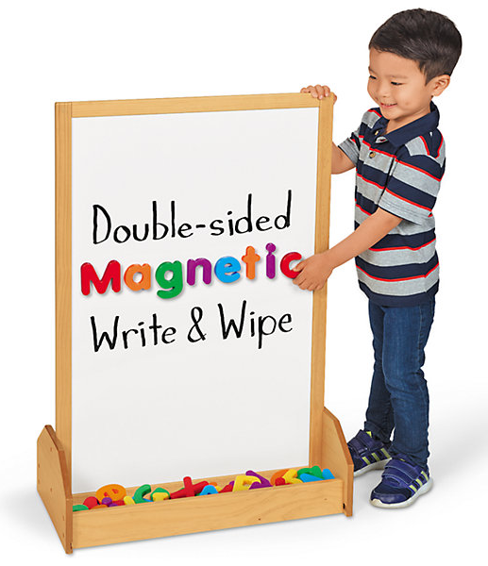
After Storytime
Picture from Flannelboard Fun on Etsy
Board from Lakeshore Learning
Playboards and pieces for kids
People you can dress up, shapes for building, matching games, creating a car from car parts
Pizza box flannels on the go

Slide 26
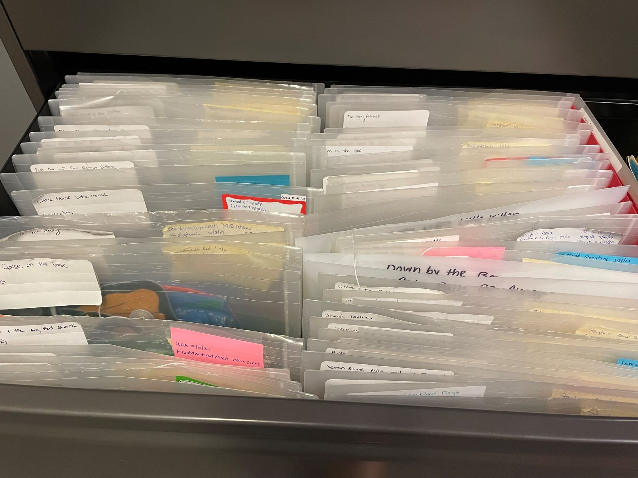
Storing Flannels
Clear Snap Folders from Amazon

Slide 27
Buying Flannels
Book Farm!
Wendy from Flannelboard Fun
Lakeshore Learning has stuffed pieces
Kaplan Early Learning

Slide 28
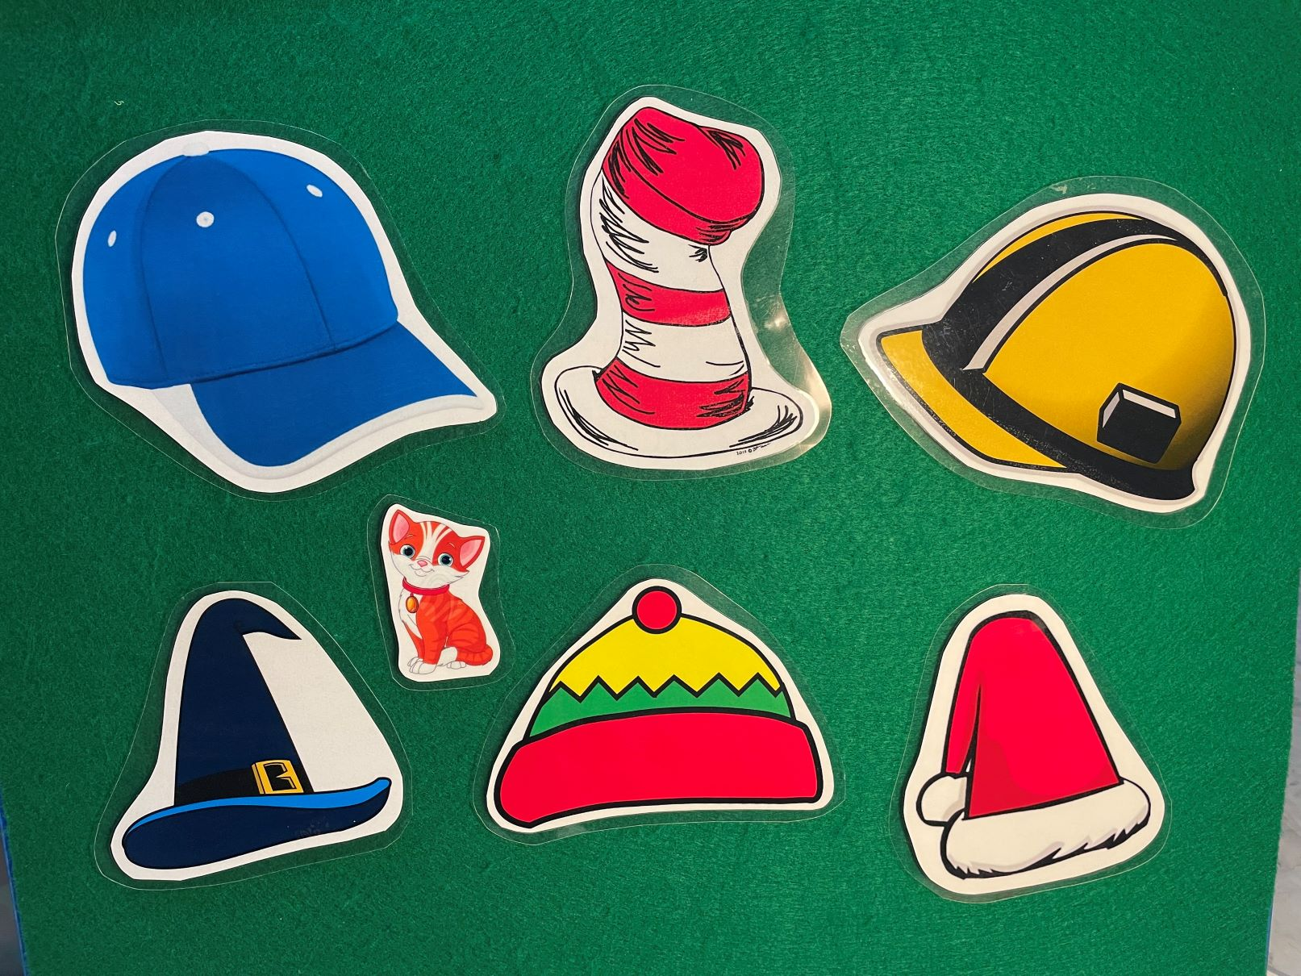
Print and Laminate

Slide 29
Buying Felt
Sheets are better than felt off the roll which can get floppy. Sheets are also easier to cut.
Buy lots of colors!
Non-fusible interfacing…? It’s a whole world out there.

Slide 30
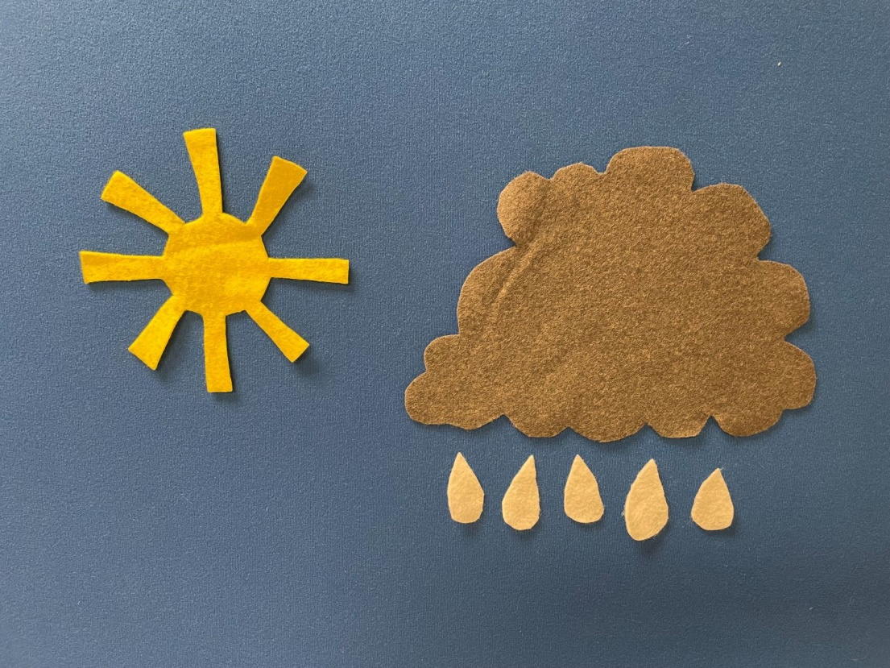
Making Patterns
Create your own by free-handing simple shapes.

Slide 31
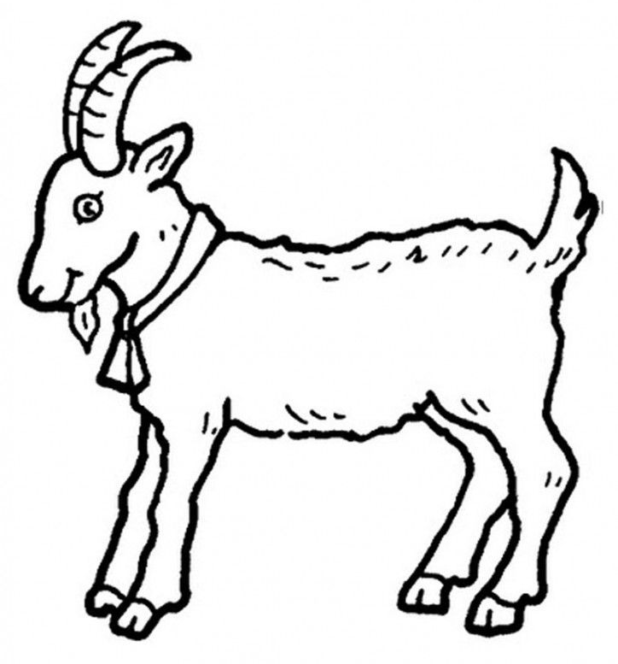
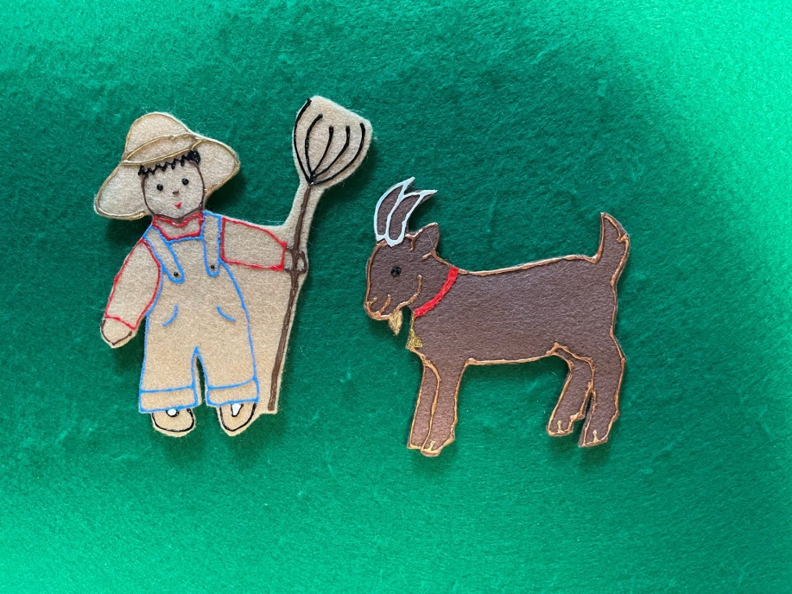
Creating Your Own Patterns
Using clip-art.

Slide 32
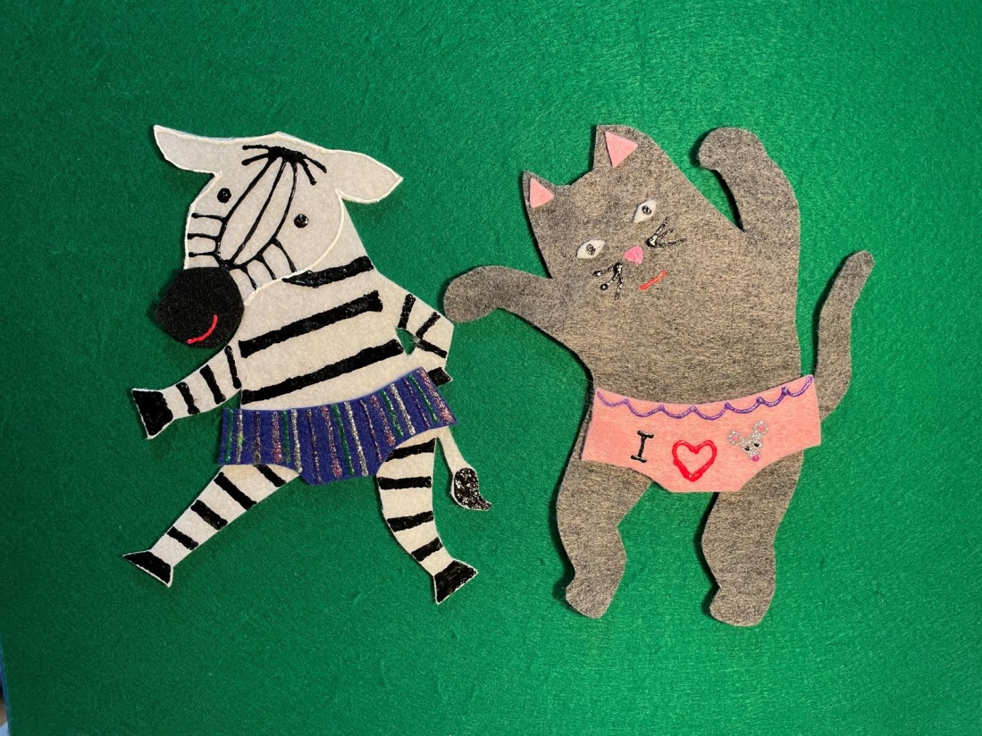
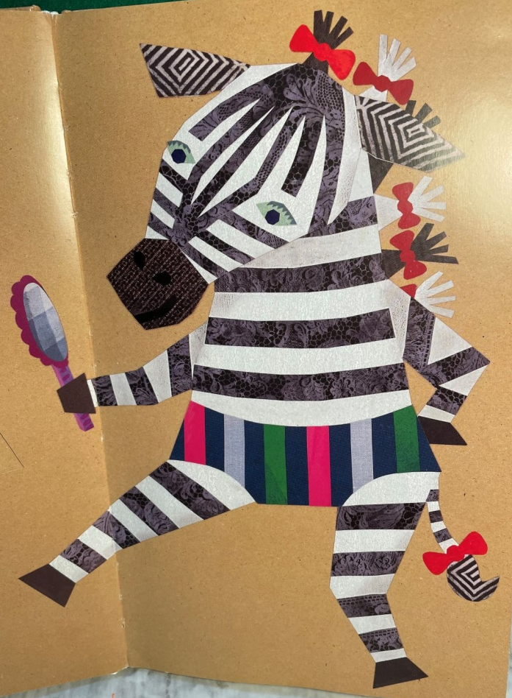
Creating Your Own Patterns
From a book!

Slide 33
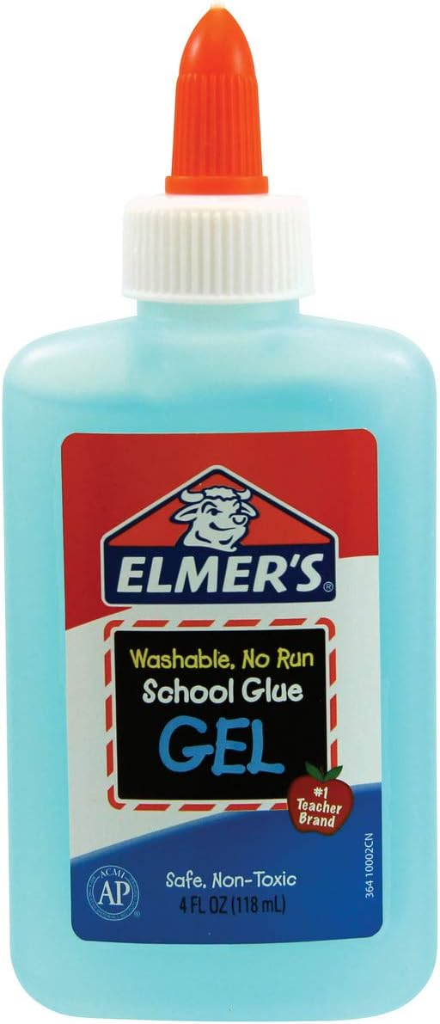
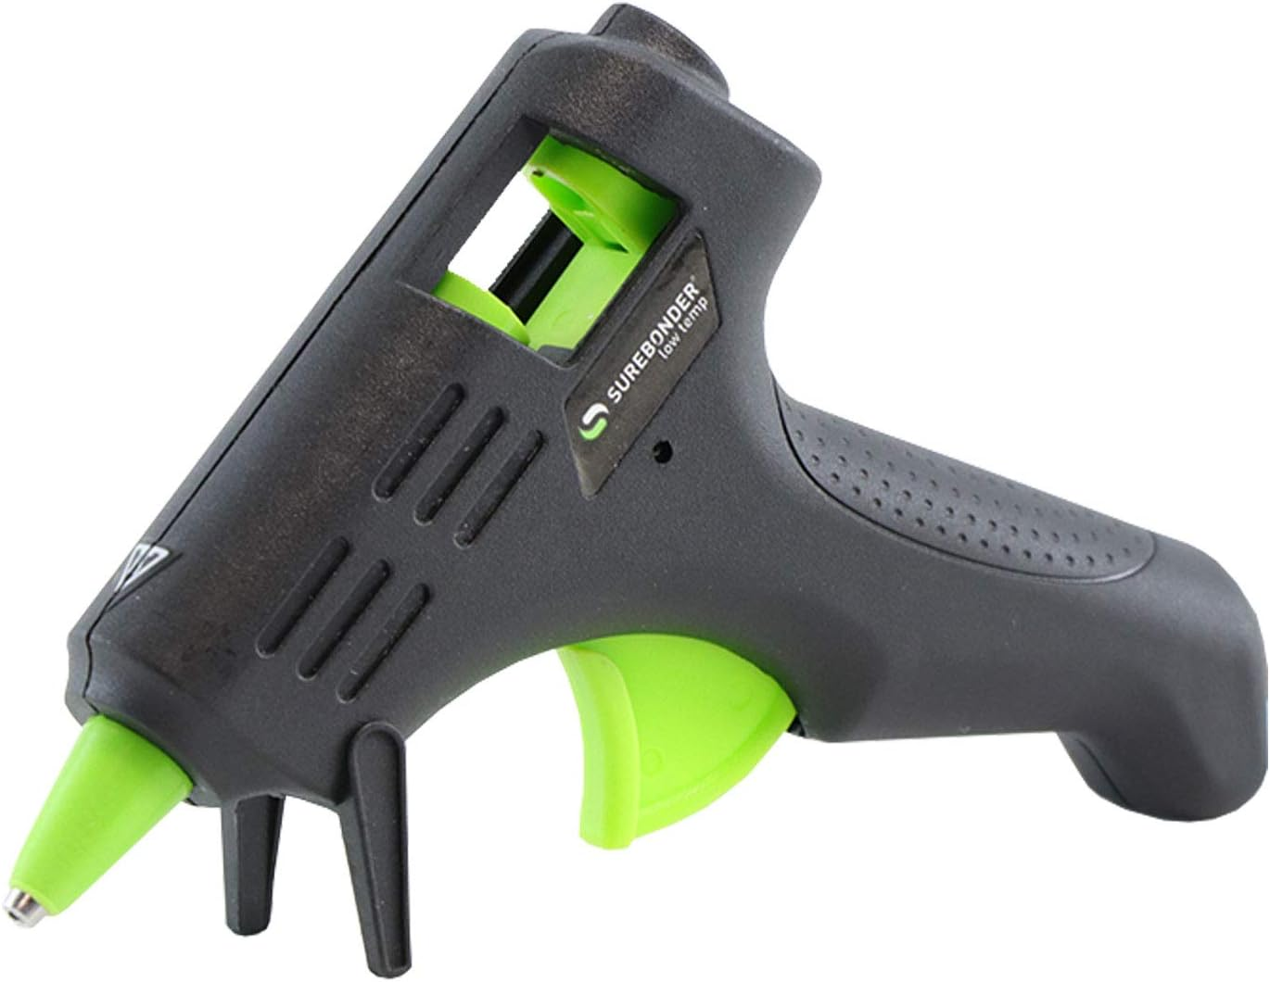
Gluing!

Slide 34
Puff Paint! Amazing and Terrible!

Slide 35
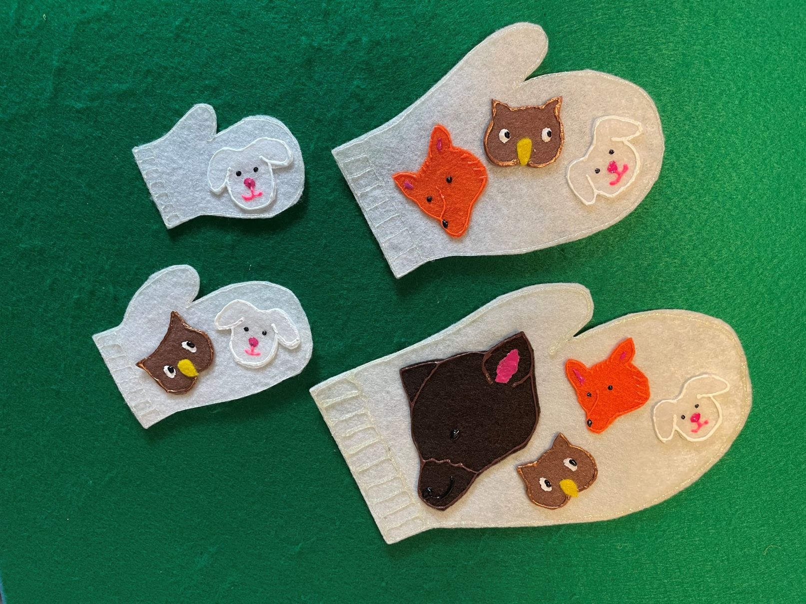
Fancy Felt
The Mitten

Slide 36
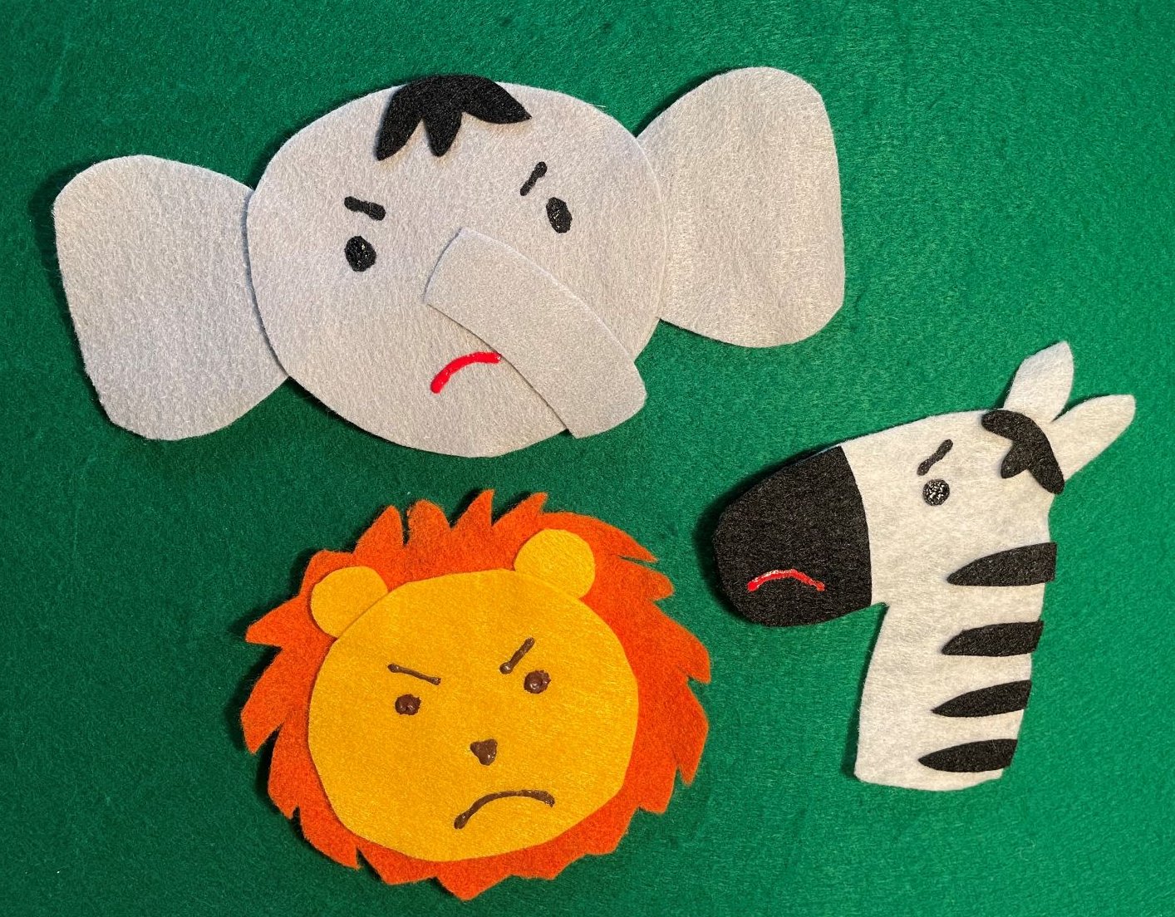
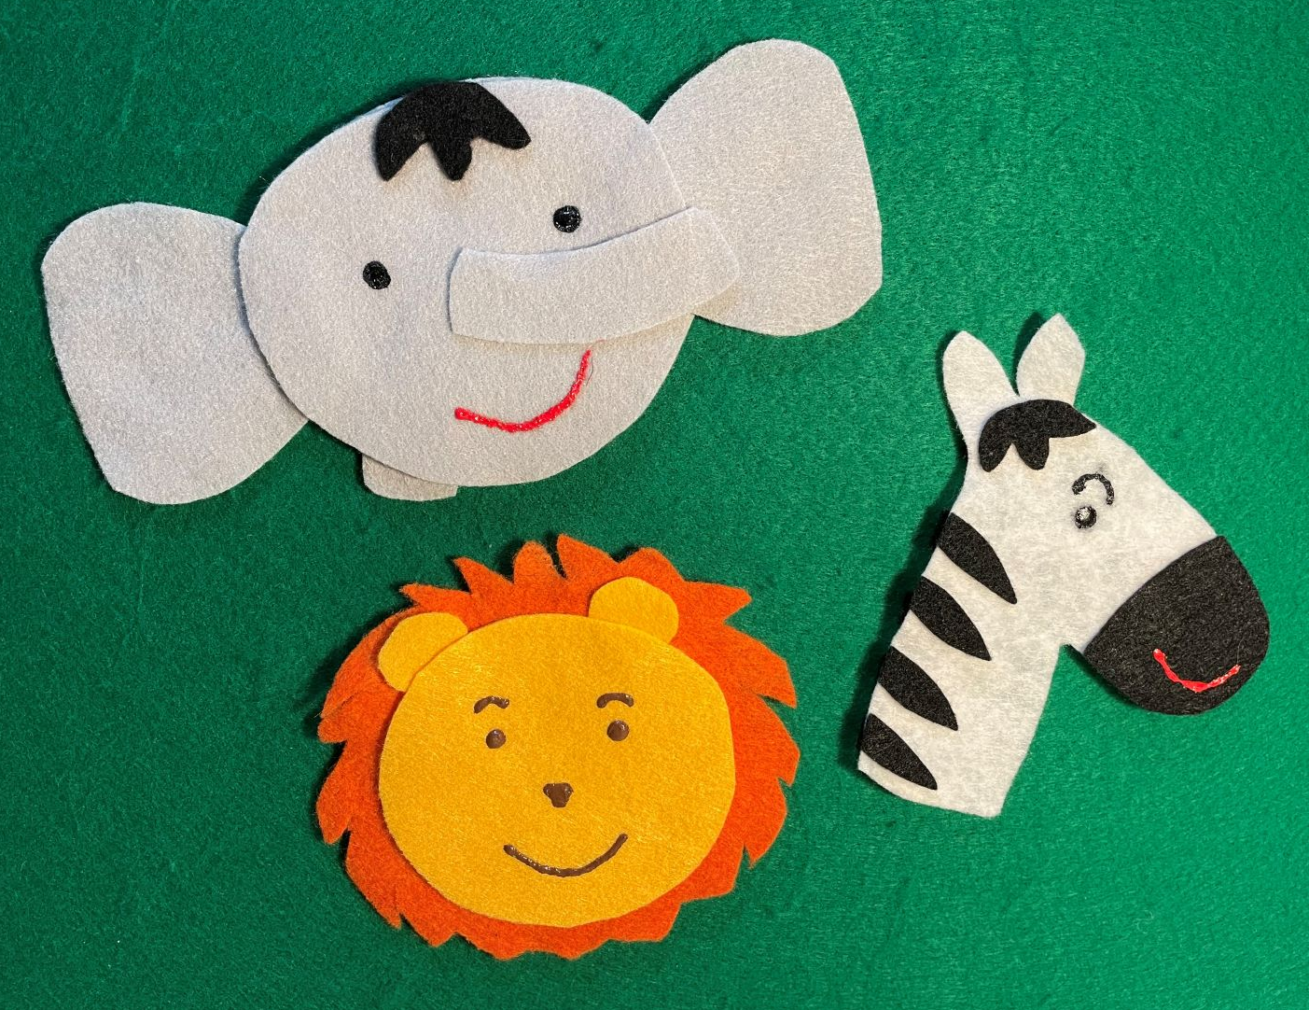
Fancy Felt
Hooray for Hat

Slide 37
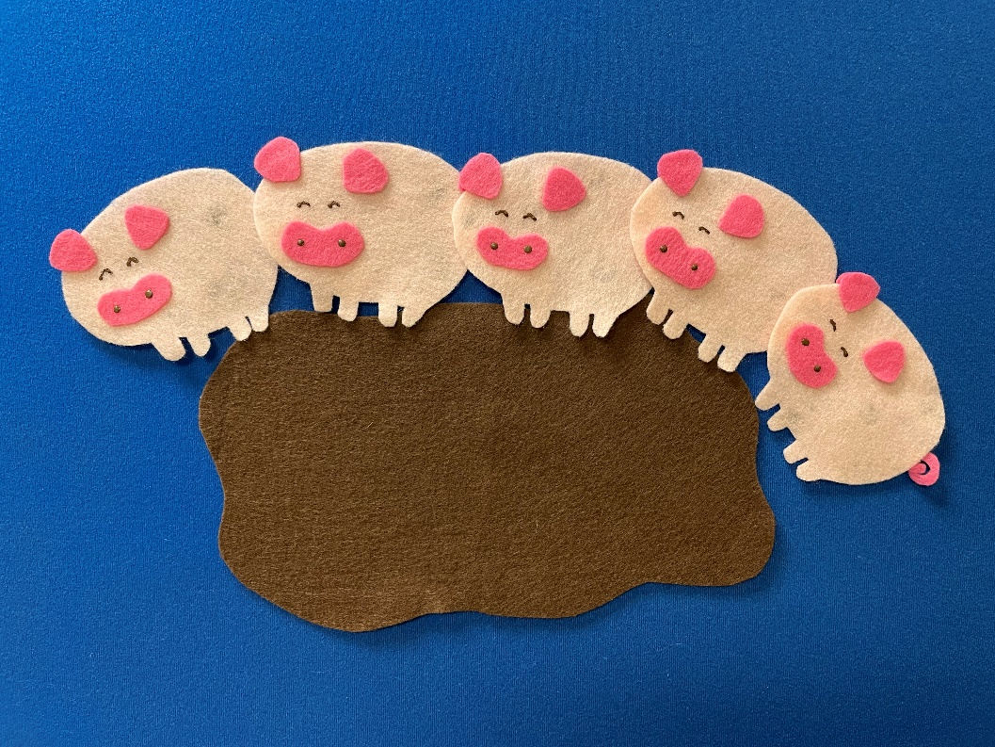
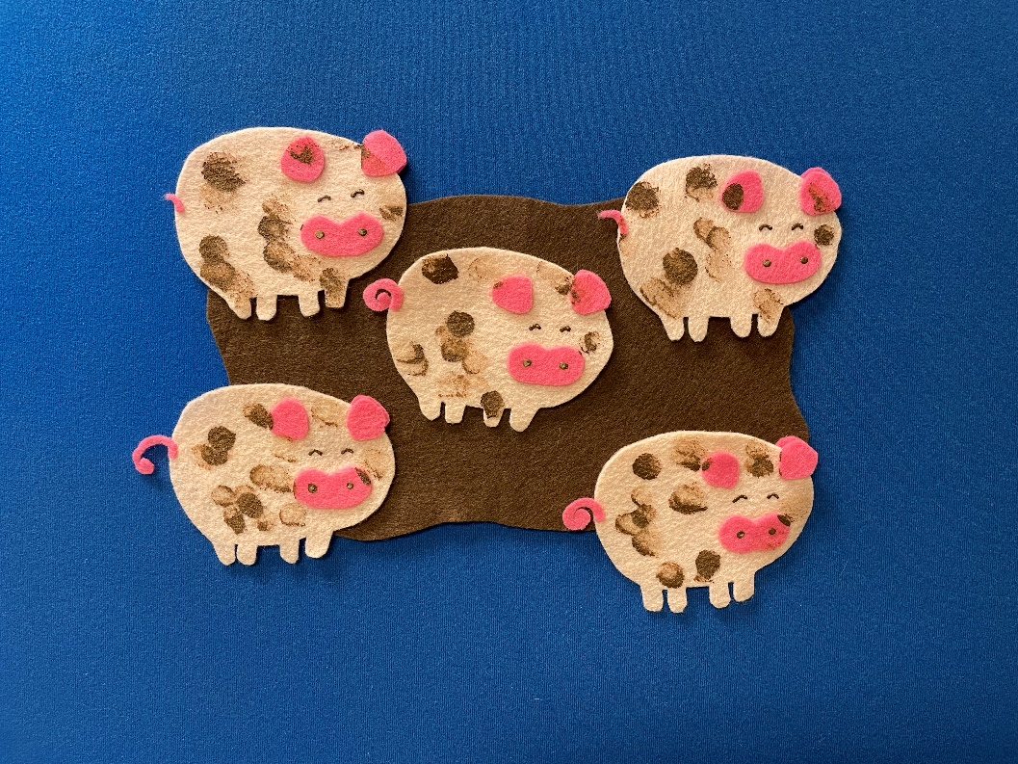
Fancy Felt
Five Clean Squeaky Pigs

Slide 38
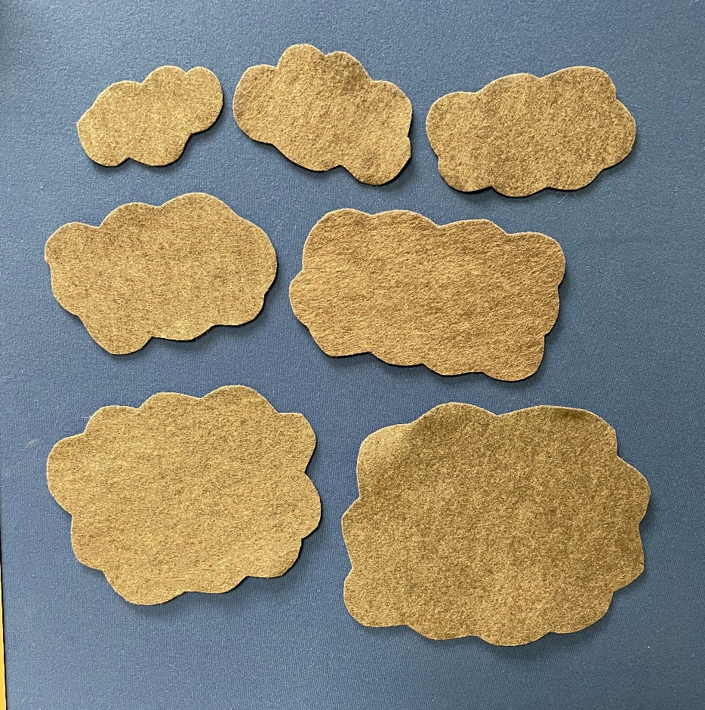
Adding Puppets/Stuffies
Grumpy Duck

Slide 39
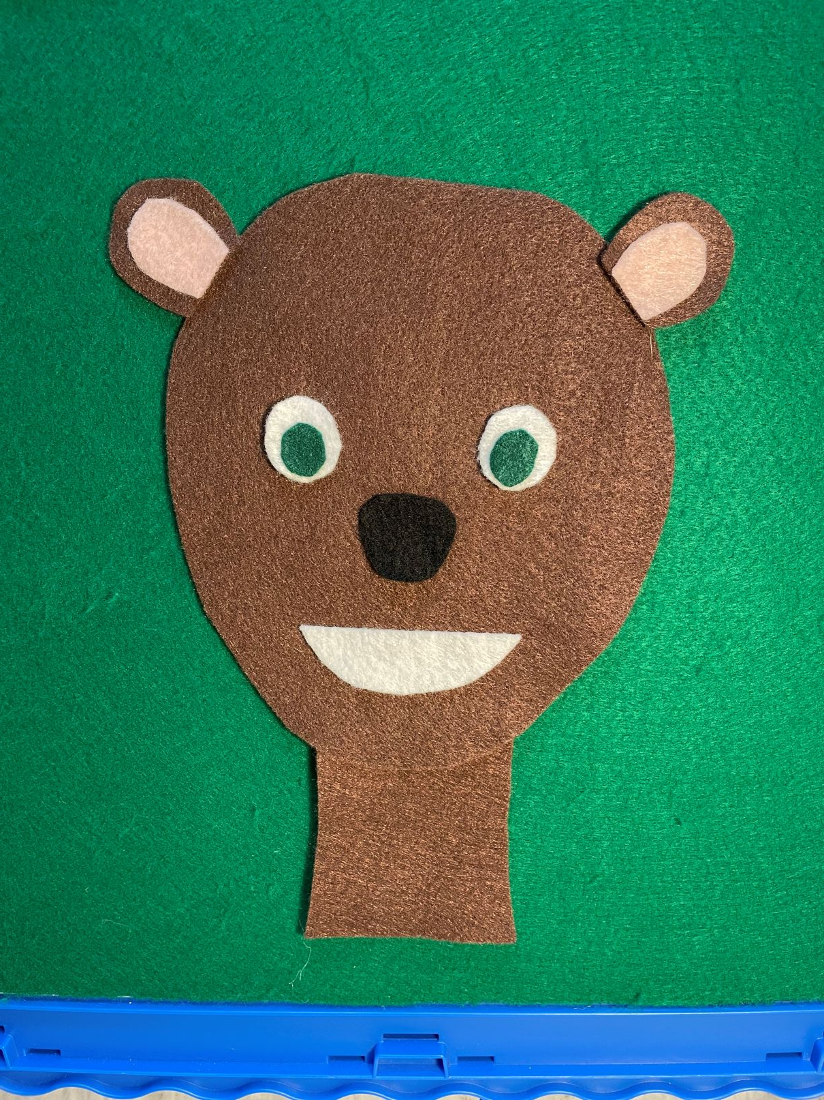
Adding Puppets/Stuffies
Bear’s Picture

Slide 40
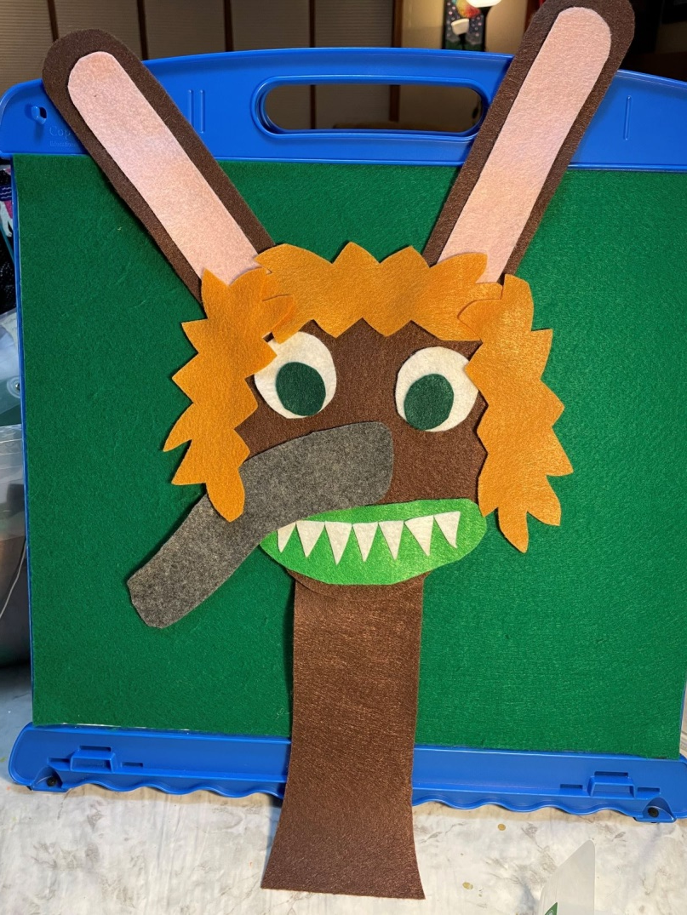
Adding Puppets/Stuffies
Bear’s Picture

Slide 41
Questions?
Laura Bultman
Youth Services Librarian
Kalamazoo Public Library
laurab@kpl.gov

Slide 42
Resources
https://www.uhls.org/workshop_handouts/Flannel_Boards_Presentation.pdf
https://jbrary.com/new-to-storytime-using-felt-stories/

Slide 43
Let’s Craft!

